Slide 1
New Class Training Directors Meeting
Mute your microphone to help with meeting noise
If you have a slow internet connection, turn off your video to keep up bandwidth
Introduce yourself & your chapter in the Chat Room
Michelle will be monitoring the chat room
We’ll get started at 1:30pm
Volunteer Note Taker – _Sheila Endres, Balcones Canyonlands___
Will be sharing notes, slides and chat room post-meeting

Slide 2
New Class Training Directors Meeting
June 18th

Slide 3
AGENDA
Survey Results
Group Gathering & Return to Service Guidelines
Indoor vs. Outdoor
Distance Basic Training
Regional WebEx Accounts
Advanced Training Calendar on State Website
Diversity & Inclusion
Annual Meeting

Slide 4
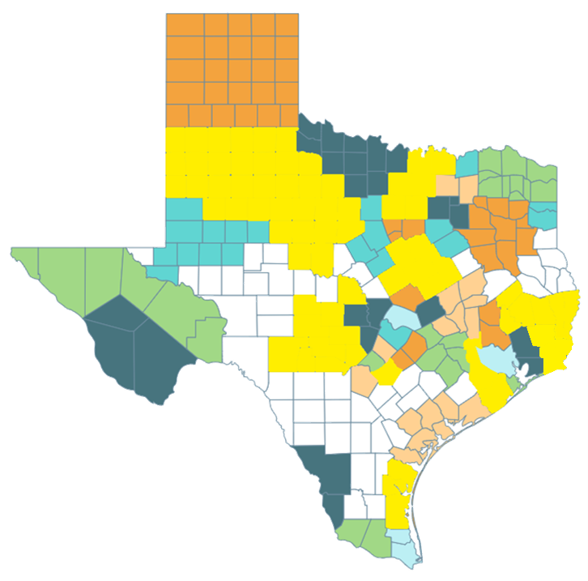
Survey Results
13 Chapters with Fall Classes →
5 Chapters working to complete Spring Classes through fall
Prairie Oaks
Mid Coast
Good Water
Llano Estacado
El Camino Real
? Chapters Still Pending Decision:
Capital Area
Indian Trail
Red River

Slide 5
Survey Results
Fall Classes
50% anticipating in person face to face trainings (with proper health restrictions followed)
35% anticipating dual virtual and in person fall training
15% planning totally virtual training class.
Logistics for Classes:
Classroom lectures will be virtual, and we will have in-person field trips in smaller groups
Limited size field trips and small-group class projects; small get-to-know-you sessions
We are still working on the details. In concept, we would ask the class members who would like to attend in-person and who would prefer to attend virtually. Our classroom can accommodate 54 people. We typically have 30 students in a class. We would allow the in-person class members up to the recommended number of people at that time (Jan. 2021) to follow all social distancing guidelines. Also we need to consider our instructors. Some may be willing to teach an in-person class. Some instructors may not. We have lots of planning to do and there is still a great deal of uncertainty. That is part of the reason to delay the start of our next class a few months.

Slide 6
Survey Results
Additional Questions from Survey:
“Having various chapters present online training could open up possibilities of sharing among chapters. It would facilitate makeup classes, but of course, we lament not meeting face to face.”

Slide 7
Group Gathering/Return to Service Guidelines
Reopening Guidance Document Waves
Wave 3 until July 1
Additional Outdoor Events Guidance Shared
Questions We Still Have:
Contact Tracing Waivers for Trainees/Attendees @ Events
Contract tracing for public versus MNs
“Gatherings” and “Events” official vs unofficial
“Better Safe Than Sorry”

Slide 8
Distance Basic Training
Chapters with Fall Training Classes :
Big Country Chapter
Bluestem Chapter
Coastal Prairie Chapter
Cradle of Texas Chapter
Cross Timbers Chapter
Elm Fork Chapter
Guadalupe Chapter
Heart of Texas Chapter
Hill Country Chapter
Pineywood Lakes Chapter
Sabine Neches Chapter
South Plains Chapter
South Texas Chapter
Caveat with basic – similar ecoregions, local ecosystem focus

Slide 9
Distance Basic Training
How can we transition to distance/virtual learning WITHOUT losing community/comradery feeling of chapters training classes?
Clearinghouse for “universal” basic training classes
If recording, send us your training videos . . .
AND Clearinghouse of recordings if already done . . .
Would this be helpful?
Will post to YouTube
Send via DropBox or Shared Drive
Video – outside classroom watching with discussion afterwards via Zoom
Universal Basic Training Classes
Land Stewardship
Historical Naturalists (?)
Ecological Regions
Ecological Concepts
Ecosystems Management
Texas Water Resources (?)
Citizen Science
Laws & Ethics
Interpretation/Volunteers as Teachers
Notes:
Should we go to Statewide Module Distance Courses for Basic Training?
Will this help chapters focus 40 hours more on local ecosystems knowledge & field based sessions?
Do we invest time in making these FULL distance courses or just record a good speaker on Zoom/YouTube for now?
If we do this distance, what does the course look like, who creates it, how do we manage this and Annual Meeting?

Slide 10
Distance Basic Training
Thinking of the two basic types of new trainees:
Education-based recruits or Service-based recruits?
Could we filter enrollment for local chapter through the cost of distance course? (waived in times of need, i.e COVID)
If we host these courses or all the units on a distance platform, what’s the value of the curriculum?
Are we going distance for ‘right now’? Or for . . . .
Long term distance training for those education-based recruits that wouldn’t give volunteer service traditionally (i.e not taking a seat in training class)?

Slide 11
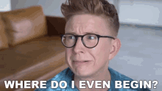
Regional WebEx Accounts
Working on them still . . .
Will be hosted through Regional Gmail Accounts as done previously
Region#TMN@gmail.com
Naturalist#!
where # is Region # - i.e Region2TMN, Naturalist2!
WebEx Capacity – 2,000 on these new accounts
No Timelimit

Slide 12
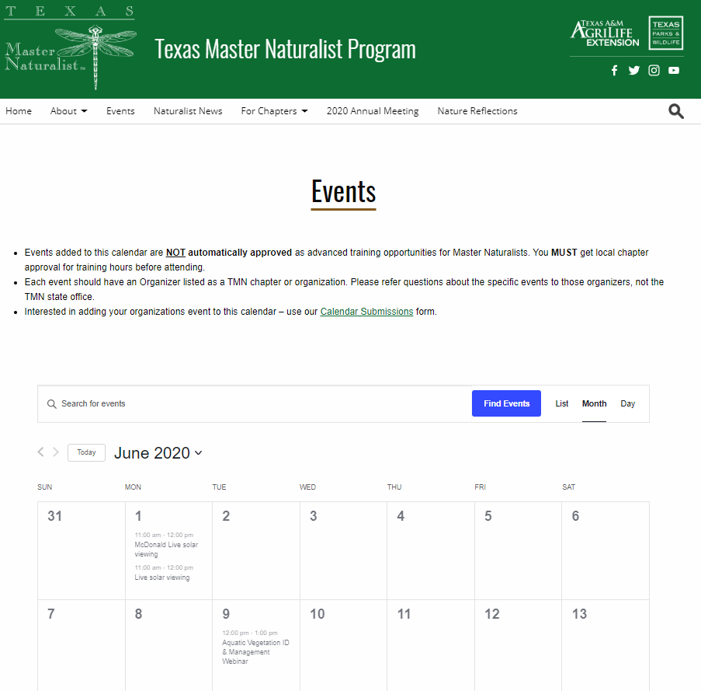
State Website Calendar
Add your chapters advanced and ‘universal’ basic training courses
Encourage chapter members to find training classes here

Slide 13
Diversity & Inclusion
State Program Statement
Agency wide discussions happening . . . Our program has to follow their lead for public statements.
BUT . . .
We can continue to discuss, plan and implement strategies for including diverse audiences as new member recruits and public event audience goals.
We have always had a State Program EEO Statement

Slide 14
Diversity & Inclusion
TMN Program EEO Statement:
The Texas Master Naturalist Program is coordinated jointly by Texas A&M AgriLife Extension Service and Texas Parks and Wildlife Department. Texas A&M AgriLife Extension Service provides equal access in its programs, activities, education and employment, without regard to race, color, sex, religion, national origin, disability, age, genetic information, veteran status, sexual orientation or gender identity. Texas Parks and Wildlife Department prohibits discrimination on the basis of race, color, religion, national origin, disability, age, and gender, pursuant to state and federal law. Individuals with disabilities requiring auxiliary aids, services or accommodations in order to participate in Extension events are required to call XXX-XXX-XXXX (local Extension Office) seven days prior to the event so appropriate arrangements can be made.

Slide 15
Diversity & Inclusion
First line of action is to have an open discussion . . .
Advertisement strategy? Language strategy?
Community inclusion culture in current membership?
Website accessibility. . .
North Texas Chapters Statement
Remember that video they did? https://youtu.be/bPksINno0Iw
Can/should chapters make statements autonomously?

Slide 16
Annual Meeting

